Slide 1


Wearable Device Posture Forecasting using Time-series Models
By
Nitin Nandeshwar
Guided By
Dr David Hawe

Slide 2
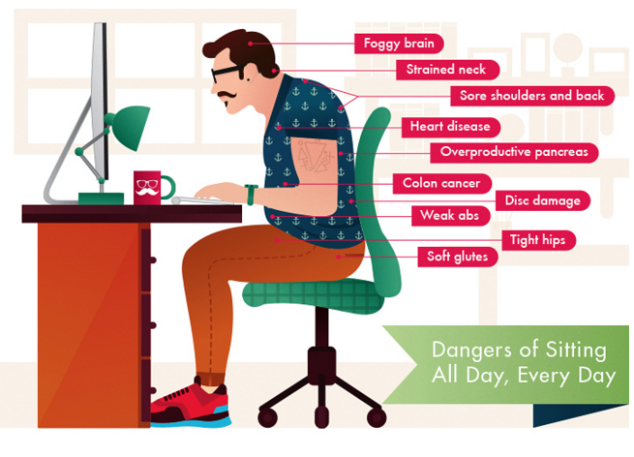

Slide 3
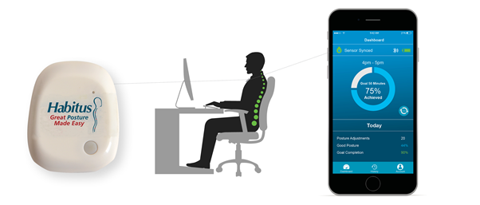
HABITUS POSTURE SENSOR & MOBILE APP

Slide 4
Problem Statement
Time series analysis. This will allow Habitus to advise employers what times of the day/days of the week their employees are displaying signs of poor posture leading to a drop in productivity, poor concentration, withdrawal from engaging in work etc.

Slide 5
Important Features
Dataset: AggregatedByStatusChanges.csv
47055 observations & 11 feature variables
Data from 10th October 2019 to 26th Feb 2020
"UserId", "DateFrom", "DateTo" and "Posture"(Data labels: Bad=1 & Good=2)

Slide 6
Data Preparation
Used R Programming to prepare data in Time series format.
Useful Data from 27th Jan 2020 to 28th Feb 2020 & 8 am to 5 pm
250 Observations & 4 Feature variables
Data:
“Datetime” : Data in datetime format
Active_User: Number of User active per hour
GP_Min: Total Good Posture time in minutes in that hour
BP_Min: Total Bad Posture time in minutes in that hour

Slide 7
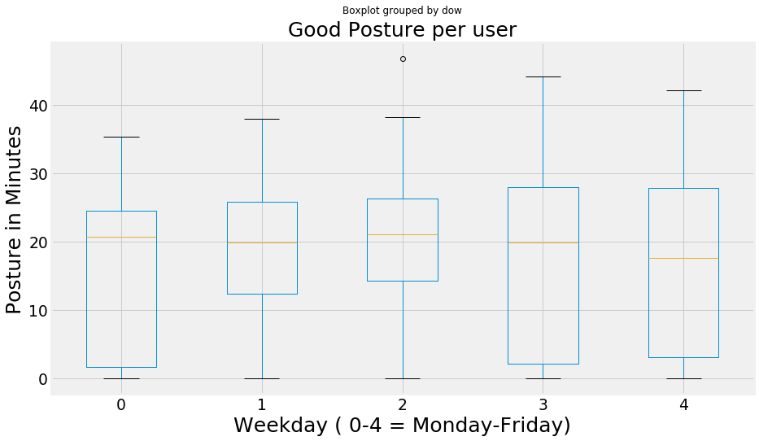
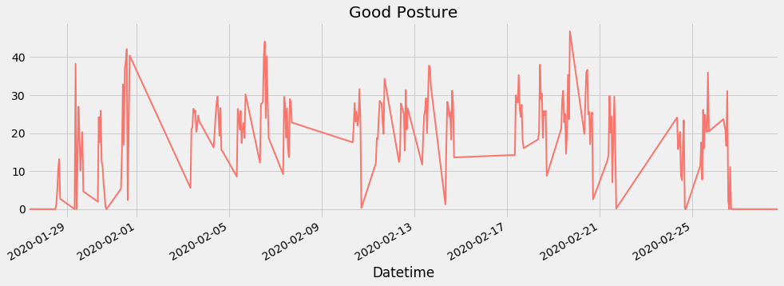
Data Visualization Good Posture Time series

Slide 8
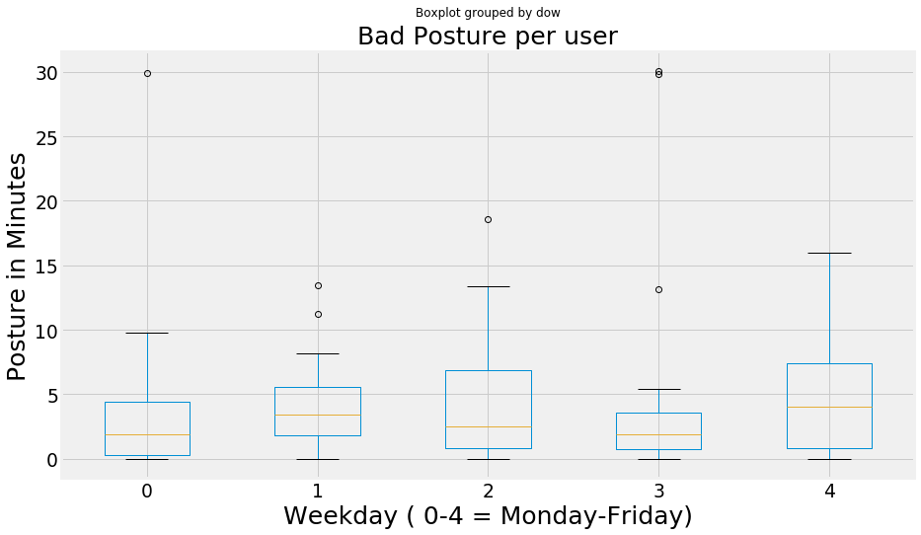
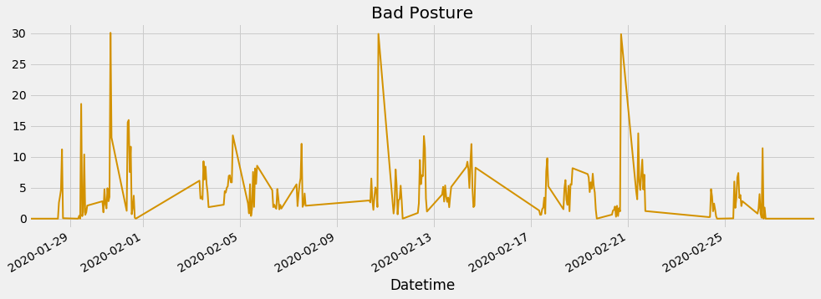
Data Visualization Bad Posture Time series

Slide 9
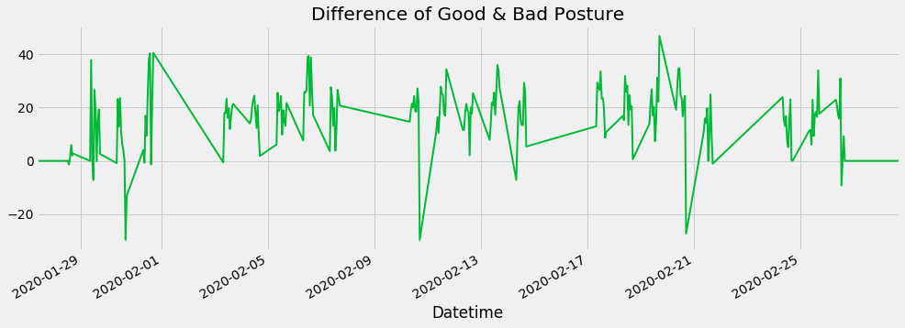
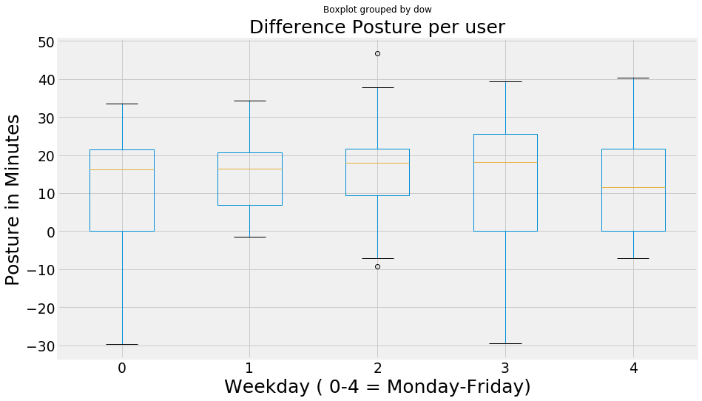
Data Visualization Difference Posture Time series

Slide 10

Time series Models
Holt-Winters Method
ARIMA Model
SARIMA Model
Prophet Forecasting Method

Slide 11
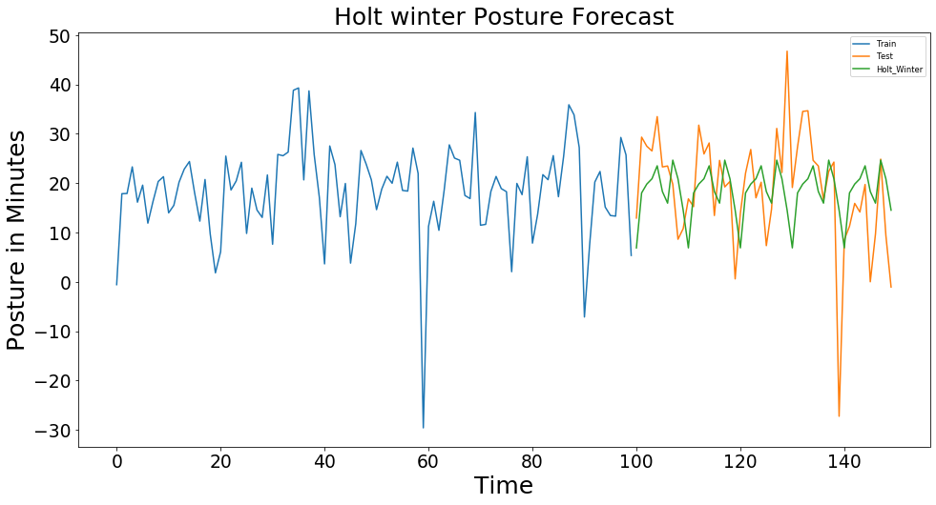
Holt-Winters Method

Slide 12
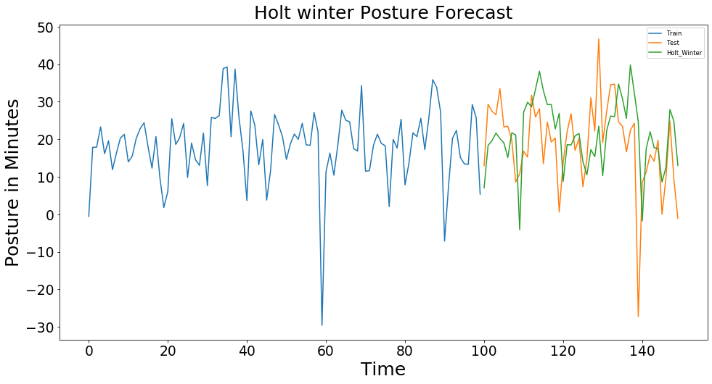
Holt-Winters Method

Slide 13
Holt-Winters Method
Time | Monday | Tuesday | Wednesday | Thursday | Friday | Global
08-09 | 7.03 | 27.22 | 8.78 | 10.29 | -1.74 | 6.88
09-10 | 18.32 | 29.89 | 18.56 | 22.32 | 17.5 | 18.01
10-11 | 19.65 | 28.64 | 18.47 | 26.19 | 21.99 | 19.85
11-12 | 21.64 | 33.34 | 20.9 | 26.04 | 17.78 | 20.89
12-13 | 20.2 | 38.12 | 21.56 | 34.74 | 17.54 | 23.52
13-14 | 19.06 | 32.95 | 14.03 | 30.8 | 8.61 | 18.3
14-15 | 15.14 | 29.23 | 10.52 | 25.58 | 12.54 | 15.94
15-16 | 21.72 | 29.24 | 17.24 | 39.81 | 27.94 | 24.66
16-17 | 21.15 | 22.76 | 15.36 | 32.33 | 24.79 | 20.66
17-18 | -4.14 | 26.91 | 23.5 | 24.65 | 13.01 | 14.52
RMSE | 9.42 | 12.99 | 9.82 | 18.82 | 8.52 | 10.85

Slide 14
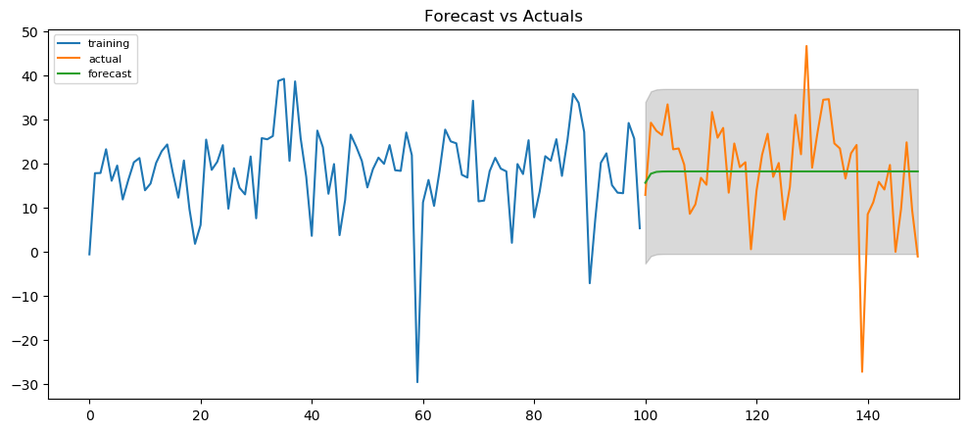
ARIMA Model

Slide 15
ARIMA Model
Time | Monday | Tuesday | Wednesday | Thursday | Friday | Global
08-09 | -31.11 | 35.39 | 14.27 | 28.25 | 17.23 | 18.26
09-10 | -32.64 | 36.46 | 15.64 | 29.28 | 17.3 | 18.26
10-11 | -34.17 | 37.53 | 16.22 | 30.31 | 17.36 | 18.26
11-12 | -35.7 | 38.6 | 16.47 | 31.35 | 17.42 | 18.26
12-13 | -37.22 | 39.67 | 16.57 | 32.38 | 17.48 | 18.26
13-14 | -38.75 | 40.74 | 16.61 | 33.41 | 17.54 | 18.26
14-15 | -40.28 | 41.81 | 16.63 | 34.44 | 17.6 | 18.26
15-16 | -41.81 | 42.88 | 16.64 | 35.47 | 17.67 | 18.26
16-17 | -43.33 | 43.95 | 16.64 | 36.51 | 17.73 | 18.26
17-18 | -44.86 | 45.02 | 16.64 | 37.54 | 17.79 | 18.26
RMSE | 59.96 | 22.91 | 11.84 | 22.6 | 9.87 | 11.47

Slide 16
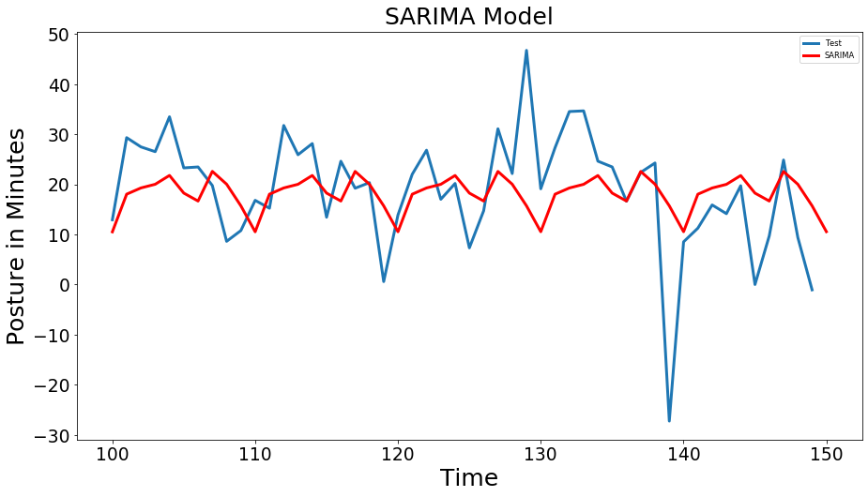
SARIMA Model

Slide 17
SARIMA Model
Time | Monday | Tuesday | Wednesday | Thursday | Friday | Global
08-09 | -46.64 | 51.53 | 10.67 | 14.78 | -15.84 | 10.52
09-10 | -42.48 | 56.63 | 10.85 | 20.66 | -1.24 | 18.04
10-11 | -39.87 | 50.74 | 17.52 | 28.66 | 11.51 | 19.29
11-12 | -41.29 | 58.76 | 20.56 | 27.64 | 13.65 | 20.02
12-13 | -37.02 | 68.06 | 18.1 | 32.53 | 6.4 | 21.78
13-14 | -42.74 | 65.38 | 17.46 | 24.19 | 4.72 | 18.26
14-15 | -42.88 | 64.94 | 1.25 | 32.4 | 4.6 | 16.67
15-16 | -34.16 | 57.8 | 19.14 | 42.83 | 20.54 | 22.59
16-17 | -39.31 | 57.17 | 16.87 | 40.79 | 17 | 20.04
17-18 | -90.86 | 74.62 | 24.55 | 34.16 | -3.36 | 15.71
RMSE | 68.64 | 43.12 | 10.89 | 22.18 | 10.38 | 10.83

Slide 18
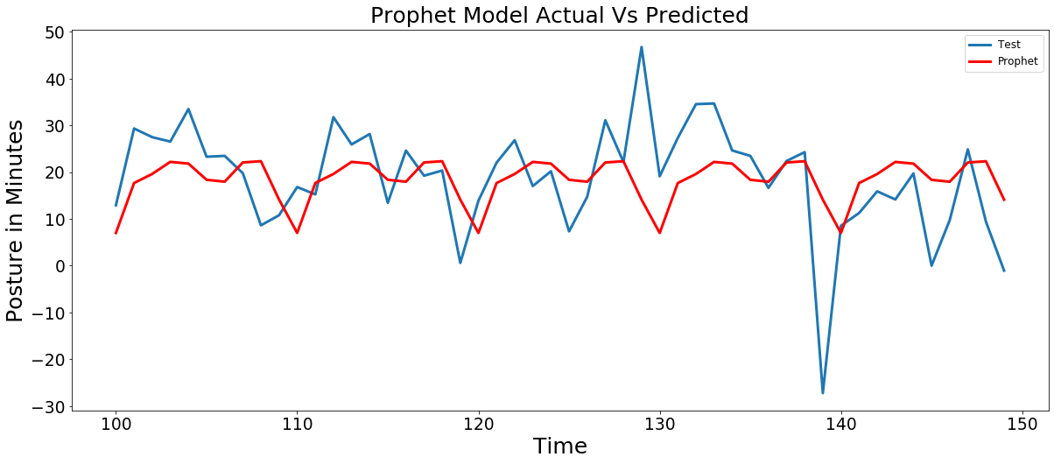
Prophet Forecasting Method

Slide 19
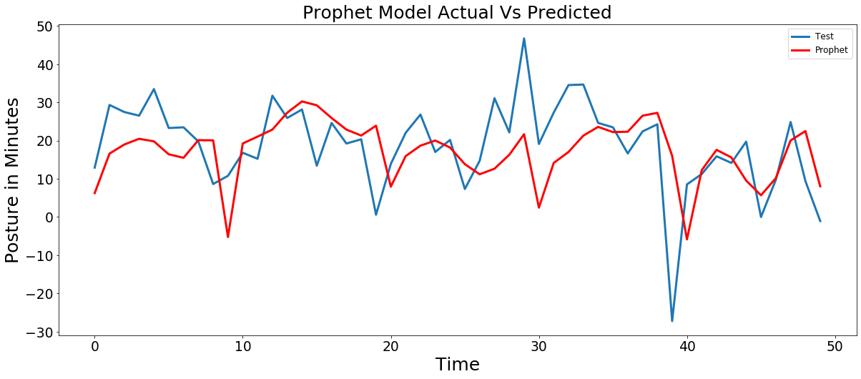
Prophet Forecasting Method

Slide 20
Prophet Forecasting Method
Time | Monday | Tuesday | Wednesday | Thursday | Friday | Global
08-09 | 6.24 | 19.25 | 7.94 | 2.46 | -5.86 | 7.05
09-10 | 16.6 | 21.05 | 15.94 | 14.15 | 12.29 | 17.72
10-11 | 18.98 | 22.89 | 18.68 | 17.03 | 17.58 | 19.66
11-12 | 20.48 | 27.3 | 20.02 | 21.29 | 15.6 | 22.24
12-13 | 19.81 | 30.26 | 18.19 | 23.6 | 9.54 | 21.88
13-14 | 16.42 | 29.24 | 13.84 | 22.23 | 5.7 | 18.41
14-15 | 15.51 | 25.91 | 11.19 | 22.32 | 10.16 | 18
15-16 | 20.13 | 22.89 | 12.65 | 26.52 | 20.04 | 22.12
16-17 | 20.07 | 21.33 | 16.29 | 27.27 | 22.5 | 22.38
17-18 | -5.24 | 23.91 | 21.68 | 16.01 | 8.04 | 14.18
RMSE | 10 | 9.66 | 11 | 16.93 | 7.91 | 10.9

Slide 21
Evaluation Metrics of Posture TSM
Model | MSE | RMSE | MAE | MAPE
Holt-Winters Method | 117.8 | 10.85 | 7.96 | 3248.89
ARIMA (p=1,d=0,q=0) | 131.57 | 11.47 | 8.41 | 3262.21
SARIMAX (1, 0, 1)x(1, 0, 1, 10) Model | 117.26 | 10.83 | 7.77 | 3244.56
Prophet Method | 118.89 | 10.9 | 7.96 | 3255.28

Slide 22
Evaluation Metrics of Posture TSM
Model | MSE | RMSE | MAE | MAPE
Holt-Winters Method | 156.24 | 12.49 | 9.544 | 1637.01
Prophet Method | 132.8 | 11.52 | 8.42 | 1110.27

Slide 23
Conclusion
SARIMA Model is better than other models when each day of week is same
Prophet Model is better when each day of week is different

Slide 24

Thank You

